Slide 1
Hashing
Session 7

Slide 2
agenda
Introduction
Static Hashing
Hash Table, Hash Function
Collision resolution techniques
Dynamic Hashing
Summary

Slide 3
Introduction
Hashing is the transformation of a string of characters into a usually shorter fixed-length value or key that represents the original string.
Hashing is used to index and retrieve items in a database.
Why? because it is faster to find the item using the shorter hashed key than to find it using the original value.
It is also used in many encryption algorithms.
Dictionary operations.
A compiler maintains a symbol table - keys are arbitrary character strings that correspond to identifiers in the language.

Slide 4
Hash table
A hash table (ht) is an effective data structure for implementing dictionaries.
The hash table associates keys with values.
Supports efficiently what is known as a lookup: given a key (e.g. a person's name), find the corresponding value (e.g. that person's telephone number).
It works by transforming the key using a hash function into a hash vale
This hash value maps directly to a bucket in the array of key/value pairs.
The hash table is partitioned into b buckets ht[0], ht[1],….., ht[b-1].

Slide 5
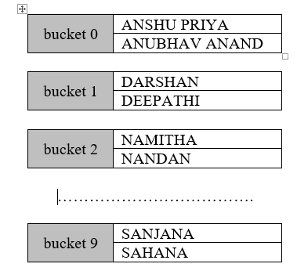
Hash table…
A bucket is a unit of storage containing one or more records (a bucket is typically a disk block).
Each bucket can consist of s slots and in a slot you can store one key/value pair.
If s = 1, essentially hash table
becomes a one dimensional array.
Example shows for s = 2.

Slide 6
Hash function
A hash table stores the keys that are mapped using a hash function, h.
Assuming, k is the key to be stored in the hash table, h is the hash function and b is the number of buckets, then k is stored in position h(k).
To search for the key k, first it is mapped using the hash function.
Then we see if there is an element at h(k) bucket.
If so, we have found the element, otherwise the element is not found.

Slide 7
example
Assume Hash function as
h (k) = k % M and s = 1
The hash table is a simple array, h[0 : M] in which the hashed key k will be stored.
f (23) = 23 % 10 = 3
f (56) = 56 % 10 = 6
f (111) = 111 % 10 = 1
f (9) = 9 % 10 = 9
f (200) = 200 % 10 = 0
h | 0 | 1 | 2 | 3 | 4 | 5 | 6 | 7 | 8 | 9
 | 200 | 111 |  | 23 |  |  | 56 |  |  | 9

Slide 8
Hash functions - Truncation
This method picks only few digits of the number and appends these digits to form the hash address.
For example, we may wish to store the telephone numbers in the hash table.
Each telephone number is a 7 digit number.
We can extract the first, third and fifth digit from the beginning of the number and concatenate these digits to form the address.
Example:
h[6605789] = 607
h[6661890] = 668
h[3351834] = 358

Slide 9
Folding
Another method is to pick group of digits, first two digits, second two digits and last three digits. Then, add these groups to get the final address. If the digits are numbered d₁, d₂,…,d₇, then the hash address is
= d₁ d₂ + d₃ d₄ + d₅ d₆ d₇
Example
h[6605789] = 66 + 05 + 789 = 860
h[6661890] = 66 + 61 + 890 = 017
h[3351834] = 33 + 51 + 834 = 918

Slide 10
Collision Resolution Techniques
Open Addressing (Rehashing)
Linear Probing
Double Hashing
Quadratic Probing
Hashing with Chains

Slide 11
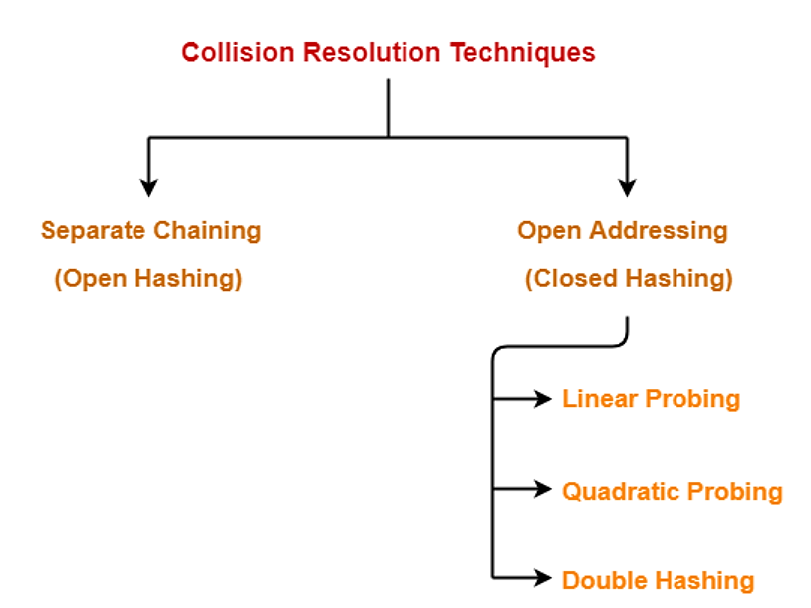
Taxonomy

Slide 12
Open Addressing
Initial Hash table
Insert 83, collision with 23, probe next available location and insert.
Insert 104, what happens?
h | 0 | 1 | 2 | 3 | 4 | 5 | 6 | 7 | 8 | 9
 | 200 | 111 |  | 23 |  |  | 56 |  |  | 9
h | 0 | 1 | 2 | 3 | 4 | 5 | 6 | 7 | 8 | 9
 | 200 | 111 |  | 23 | 83 |  | 56 |  |  | 9

Slide 13
Open Addressing…
In open addressing, each position in the array is in one of three states, EMPTY, DELETED, or OCCUPIED.
If a position is OCCUPIED, it contains a legitimate value (key and data); otherwise, it contains no value. Positions are initially EMPTY.
If the value in a position is deleted, the position is marked as DELETED, not EMPTY: the need for this distinction is explained below.
Step 1: Compute the position at which V ought to be stored, P = H(key(V)).
Step 2: If position P is not OCCUPIED, store V there.
Step 3: If position P is OCCUPIED, compute another position in the table; set P to this value and repeat (2)-(3).

Slide 14
Getting next empty location
If the hash address is empty we can insert the key, else rehash the key using the following formula,
f (k) = k % M
f’ (k) = (f (k) + 1) % M
For example, let us assume k = 83.
f (83) = 83 % 10 = 3
f’ (k) = (3 + 1) % 10 = 4
Therefore, we can insert element 83 in the location h[4].

Slide 15
1. Linear Probing
H(k) = k mod 10

Slide 16
2. Double hashing
In double hashing, there are two hash functions. The second hash function is used to provide an offset value in case the first function causes a collision.
h(k, i) = ( h₁​(k) + i * h₂​(k) ) % m
Suppose h₁(k) = (k mod 10) & h₂(k) = 1 + (k mod 7)
Insert 35: h(k) = 35%10 = 5, Collision!
h(35,1) = (5 + 1*(1 + 35 mod 7)) mod 10 = 6.

Slide 17
Contd…
Insert 25:
h(25,1) = (5 + 1*(1 + 25 mod 7)) mod 10 = 0.
Insert 75:
h(75,1) = (5 + 1*(1 + 75 mod 7)) mod 10 = 1.
75

Slide 18
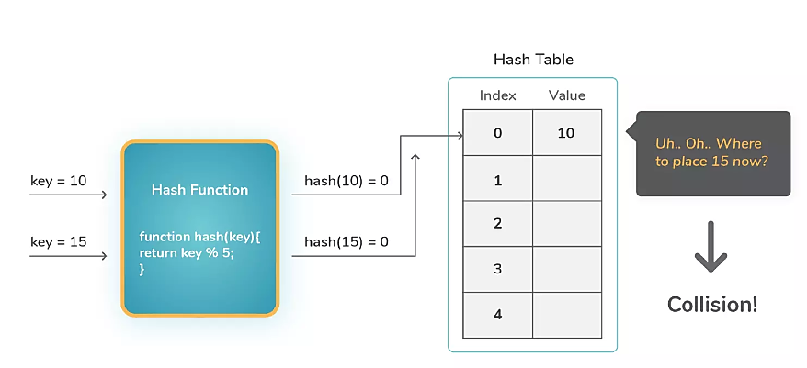
Double hashing…
Alternate formula:
h(k, i) = ( h₁​(k) + i * h₂​(k) ) % m
h₁ - first hash function & h₂ - second hash function
i = 1, 2, 3, .... (collision number)
m – hash table size
New Location of key 15 = h₁​(15) + i * h₂​(15)
= 0 + (1 * 15 % 7) = location 1

Slide 19
Example…
0
1 | 79
2
3
4 | 69
5 | 98
6
7 | 72
8
9 | 14
10
11 | 50
12
Insert the keys 79, 69, 98, 72, 14, 50 into the Hash Table of size 13. Resolve all collisions using Double Hashing where first hash-function is
h(k, i) = ( h₁​(k) + i * h₂​(k) ) % m
h₁​(k) = k mod 13
h₂​(k) = 1 + (k mod 11)

Slide 20
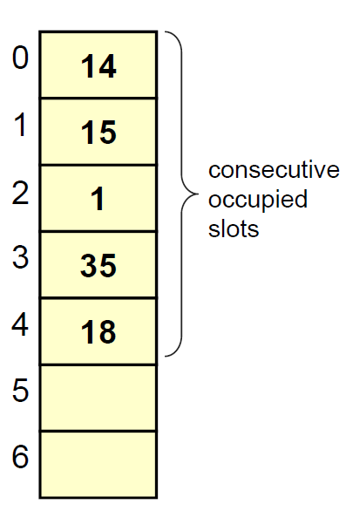
3. Quadratic probing
Primary Clustering
A cluster is a collection of consecutive occupied slots.
A cluster that covers the home address of a key is called the primary cluster of the key
Linear probing can create large primary clusters that will increase the running time of find/insert/delete operations

Slide 21
Quadratic probing…
The probe sequence of this linear probing is hash(key)
( hash(key) + 1 ) % TABLE_SIZE
( hash(key) + 2 ) % TABLE_SIZE
( hash(key) + 3 ) % TABLE_SIZE
….
The probe sequence of quadratic probing is hash(key)
( hash(key) + 1 ) % TABLE_SIZE
( hash(key) + 4 ) % TABLE_SIZE
( hash(key) + 9 ) % TABLE_SIZE
…..
(hash(key) + k² ) % TABLE_SIZE

Slide 22
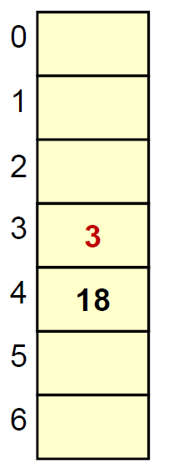
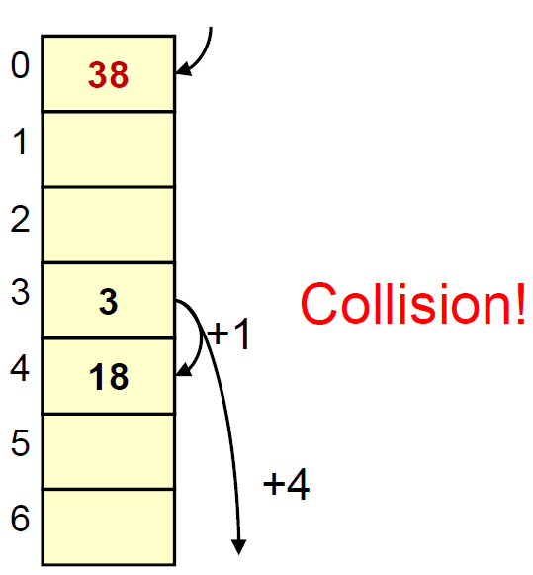
EXAMPLE
Insert 18, 3
hash(k) = k mod 7
hash(18) = 4
hash(3) = 3
Insert 38
hash(k) = k mod 7
hash(38) = 3
(hash(key) + k² ) % TABLE_SIZE

Slide 23
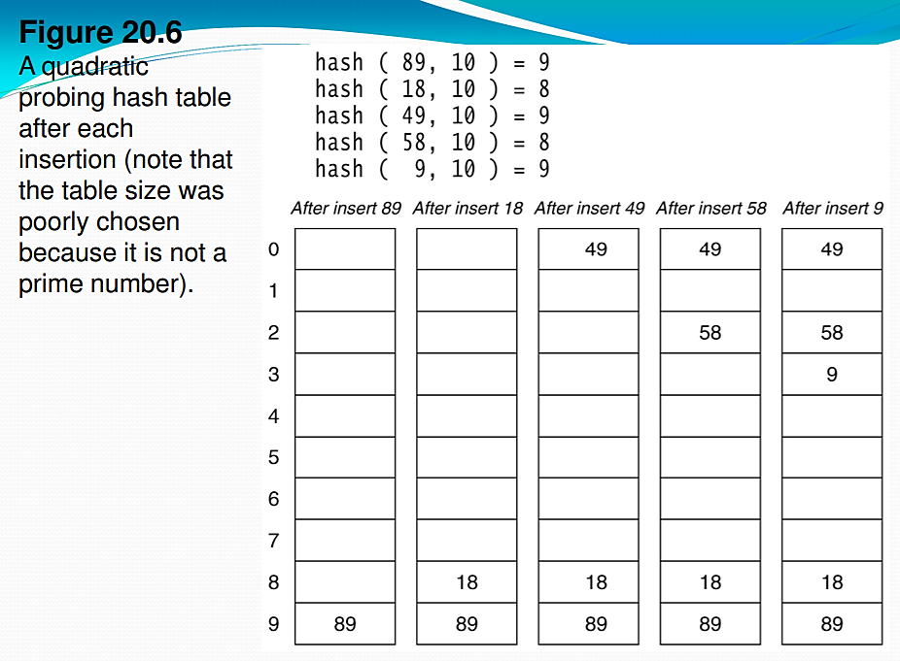
Example 2
( hash(key) + 1 ) % TABLE_SIZE
( hash(key) + 4 ) % TABLE_SIZE
( hash(key) + 9 ) % TABLE_SIZE

Slide 24
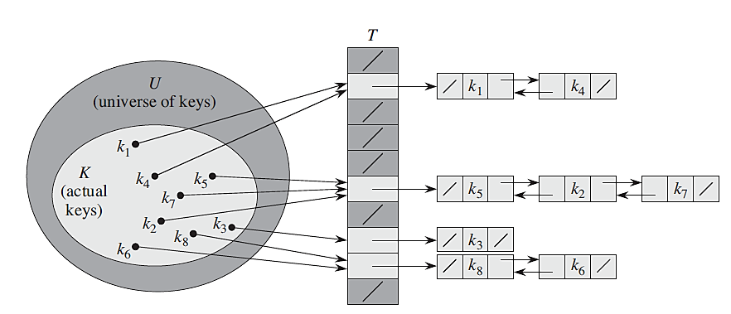
Hashing with Chains

Slide 25
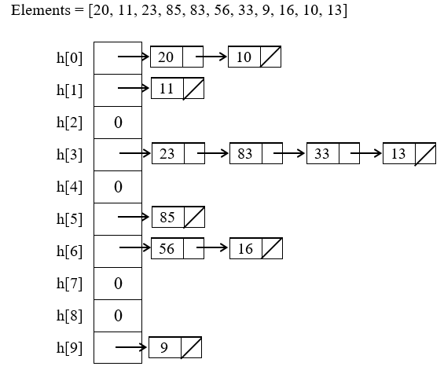
Hashing with Chains
When a collision occurs we don’t need to probe the hash table, instead of a chain or a linked list of elements are created.
In a hash table in which collisions are resolved by chaining, a successful search takes average-case time Θ(1+α), under the assumption of simple uniform hashing.
α = n/ m = O(m)/m = O(1)

Slide 26
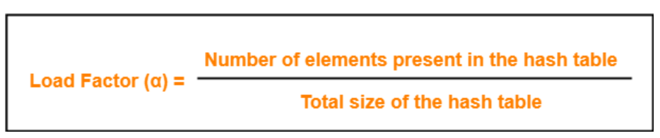
Load factor
In open addressing, the value of load factor always lie between 0 and 1.
This is because-
In open addressing, all the keys are stored inside the hash table.
So, size of the table is always greater or at least equal to the number of keys stored in the table.

Slide 27
Hash insert
int Insert (int h [], int k)
{
int j = HSearch(h, k);
if (h[j] == empty)
{
h[j] = k; /* insert */
return true;
}
if (h[j] == k || j == empty)
return false; /* duplicate or table full */
}

Slide 28
Hash search
int HSearch (int h [], int k)
{
int i = k % Size; /* hash function */
int j = i;
do
{
if (h[j] == empty || h[j] == k)
return j;
j = (j + 1) % Size; /* rehash function */
} while (j != i); /* search wrap around */
return false; /* table full */
}

Slide 29
Dynamic Hashing
In static hashing, function h maps search-key values to a fixed set b of bucket addresses. As the database grows over time, we have three options:
Choose hash function based on current file size. Get performance degradation as file grows.
Choose hash function based on anticipated file size. Space is wasted initially.
Periodically re-organize hash structure as file grows. Requires selecting new hash function, recomputing all addresses, and generating new bucket assignments. Costly, and shuts down database.

Slide 30
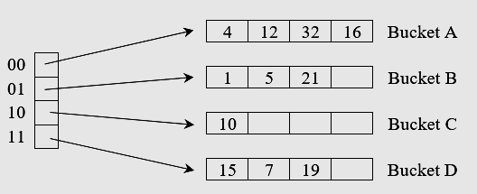
Concept
Use a directory, d of pointers to buckets. s, and double the size of the number of buckets by doubling just the directory and splitting only the bucket that overflowed.
h(k, 2) for indexing where k refers to the key being hashed and 2 is the number of bits.
key (k) | Binary equivalent h(k)
1 | 000001
4 | 000100
5 | 000101
7 | 000111
10 | 001010
12 | 001100
15 | 001111
16 | 010000
19 | 010011
21 | 010101
32 | 100000

Slide 31
Insertion
What happens when a data is inserted into a full bucket?
Consider the insertion of data entry 20 (binary 10100).
Looking at directory clement 00, the arc led to bucket A, which is already full.
We must first split the bucket by creating a new bucket, E and redistribute the existing elements.
Now the overflowed bucket A is split using h(k, u), thus increasing the directory depth by 3.
In our case u = 3, getting 8 directory entries.

Slide 32
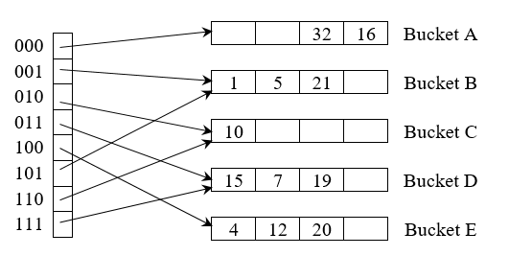
Example
Now h(20, 3) would give us 101100. So 100 directory pointer should point to the new bucket E. But the existing data in bucket A may have to be redistributed. We have 4, 12, 32, and 16 in bucket A. Considering 3 bit hashing, we have:
4 : 000100
12 : 001100
32 : 100000
16 : 010000
------------
20 : 101100
Out of these four data, 4 and 12 should be pushed to bucket E and 32 and 16 can be retained in bucket.

Slide 33
Summary

